Slide 1
More Academic Books
Information System
Case Study

Slide 2

System Activity Diagram
Describes various user activities
Describes the flow of activities through the system
Defines typical users of system

Slide 3
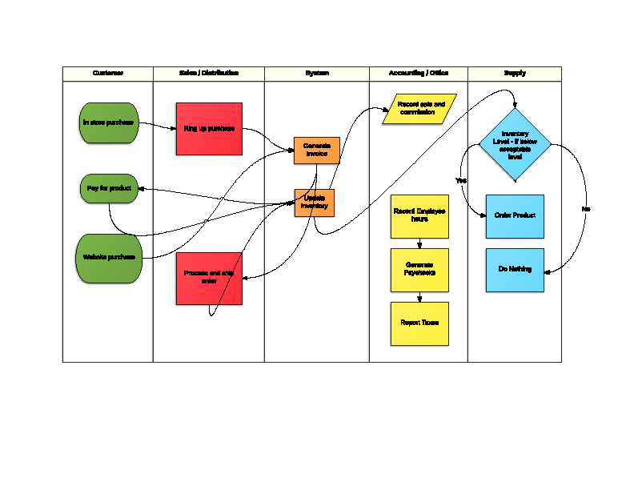
Activity Diagram

Slide 4
Use Case Diagram
Used to help understand the business process
Identifies the flow of events
Identifies various roles and how users use those roles to interact with the system

Slide 5
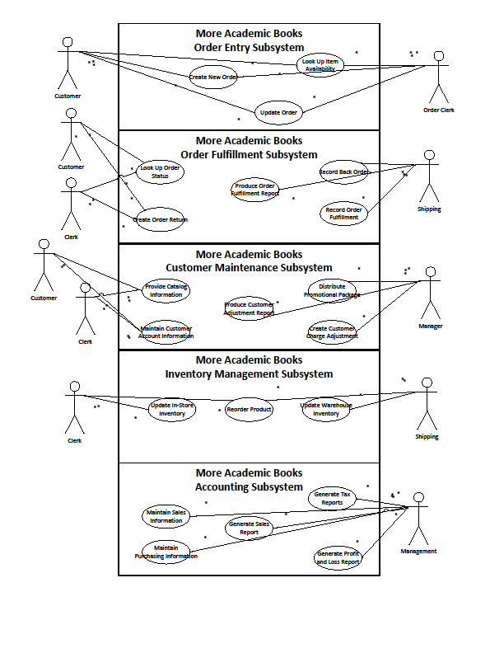
Use Case Diagram

Slide 6
System Sequence Diagram
Shows the sequence of messages between an external actor and the system
Illustrates how uses cases must interact to perform necessary actions

Slide 7
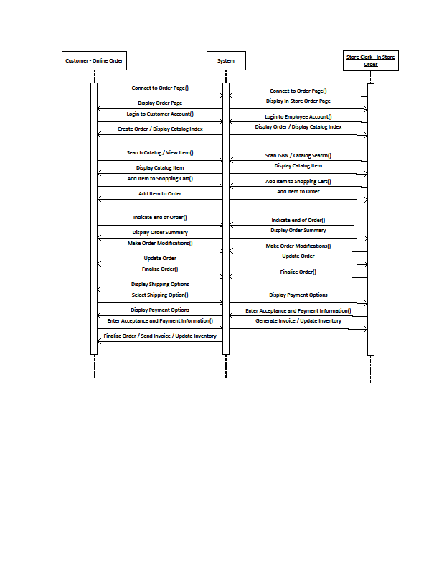
System Sequence Diagram

Slide 8
Simple Network Diagram
Used to define network infrastructure necessary to deploy system
Shows projected additional store locations
Shows database and server assets

Slide 9
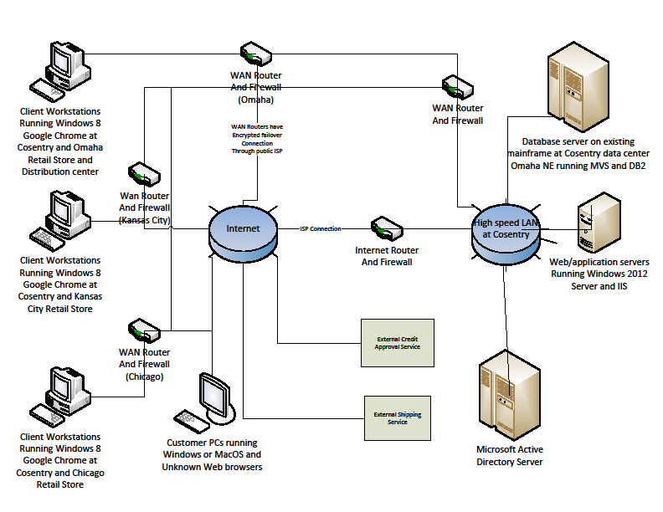
Simple Network Diagram

Slide 10
Package and Class Diagram
Package diagram is used to show which layers of the system each class belongs to
Package diagram also shows interactions between layers and their classes
Class Diagram is used to define the specific classes to be coded to satisfy use cases

Slide 11
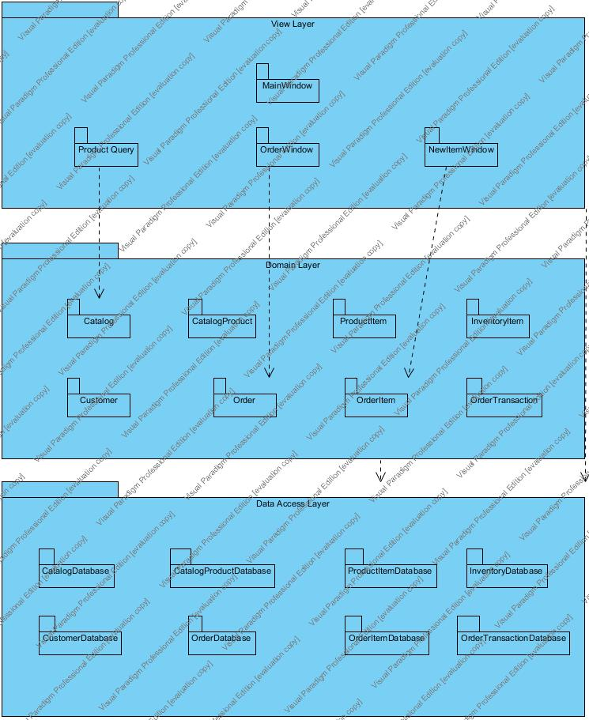
Package Diagram

Slide 12
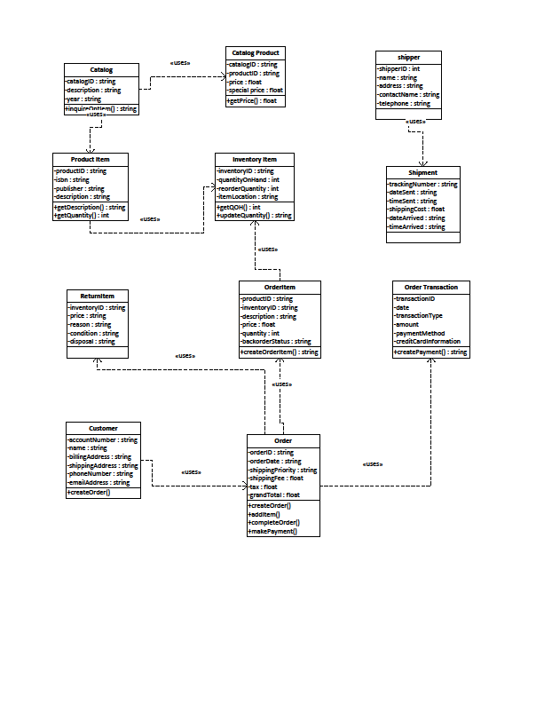
Class Diagram

Slide 13
Database Schema
Defines how data will be stored in the database
Identifies primary and foreign keys for database tables

Slide 14
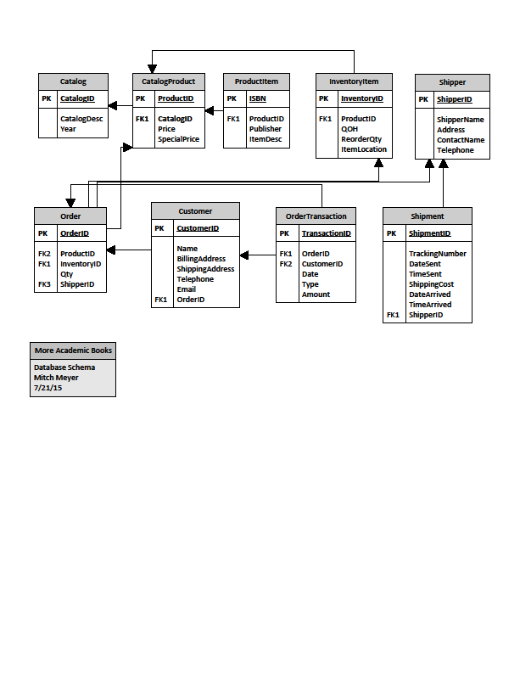
Database Schema

Slide 15
Menu Hierarchy
Defines how the user interface will act
Categorizes use cases together in user interface

Slide 16
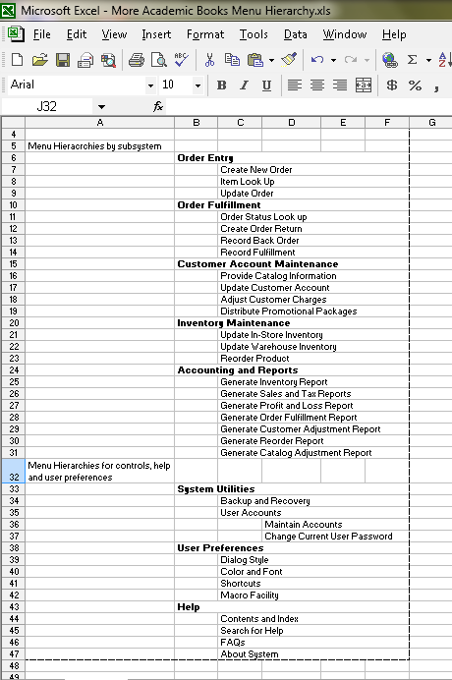
Menu Hierarchy

Slide 17
Sample Report
Reports to be generated by the system for administrative purposes
Sales database report
Inventory report

Slide 18
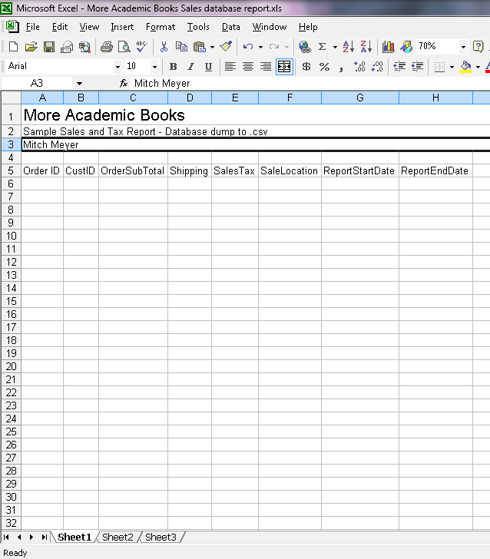
Sales Database Report

Slide 19
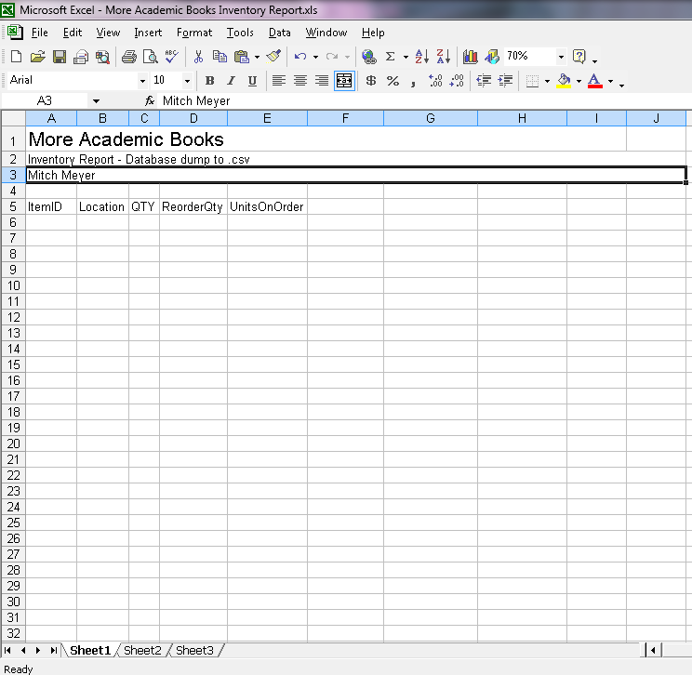
Inventory Report

Slide 20
Implementation, testing, and training plan
Over all plan for system development and deployment
Define which components will be developed and when
Define where testing will be done and on what components
Define when training will begin and on what parts of the system.

Slide 21
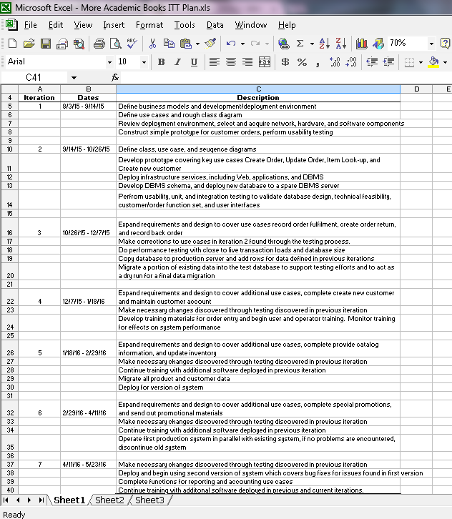
Implementation, testing, and training plan

